Slide 1
Slide 1
A Review of various
Optimizers and Activations Functions
in Neural Networks
Gokul Packirisamy
Notes:
These can be changed to reflect your school’s specific rules.

Slide 2
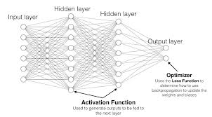
Table of Content
Introduction
Types of Optimizers
Cheat sheet – what optimizer to use and where?
Types of Activation function
Cheat sheet – what Activation function to use and where?

Slide 3
Introduction
Optimizers
Activation Function
Optimizers are algorithms or methods used to minimize an error function and increase the performance of model.
Optimizers work model’s learnable parameters mathematically like, Weights & Biases.
Optimizers changes weights and learning rate of neural network effectively.
Since Neural networks have thousand of tunable parameters to be tuned in order decrease loss function which optimizers handle very efficiently with mathematical function.
The activation function decides whether a neuron should be activated or not by calculating the weighted sum and further adding bias to it.
In back-propagation, we update weights and biases based on the error at the output. Here, Gradients are supplied with the error to update along with the weights and bias.
The output of a neuron without an activation function is just a linear regression. The non-linear transformation handled by activation function to undergo complex tasks.
Activation func
Activation Func
Optimizer
Input
Feed forward
hidden
Output
Backward Propagation

Slide 4
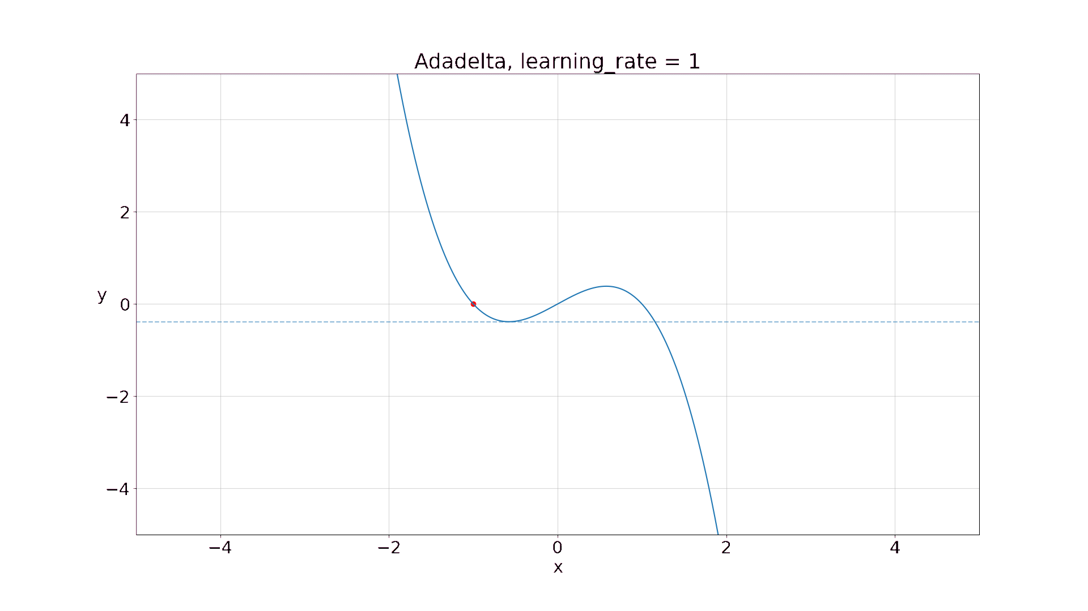
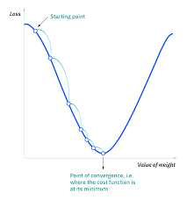
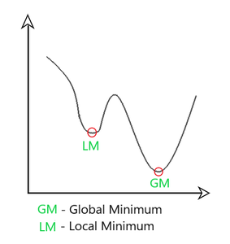
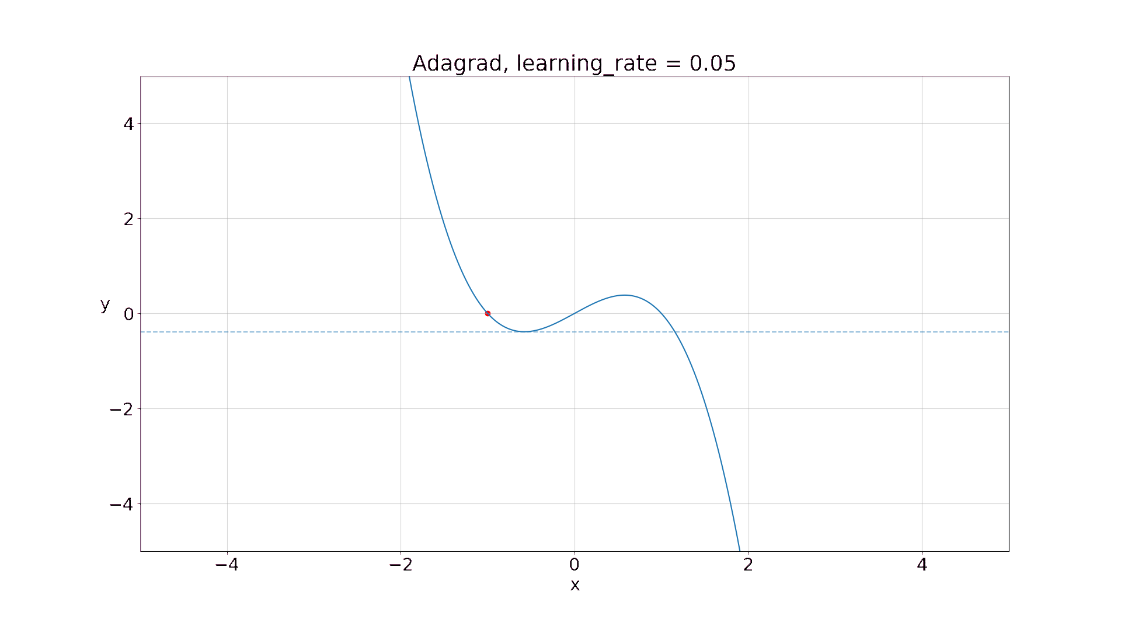
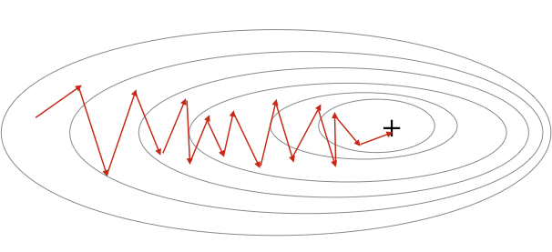
Types of Optimizers
Gradient Descent
Stochastic Gradient Descent
Ada grad
Ada delta
Adam
Gradient Descent
Adadelta
Stochastic Gradient Descent
Adam
Adagrad

Slide 5
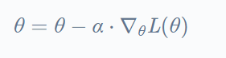
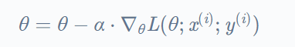
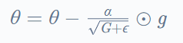
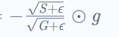
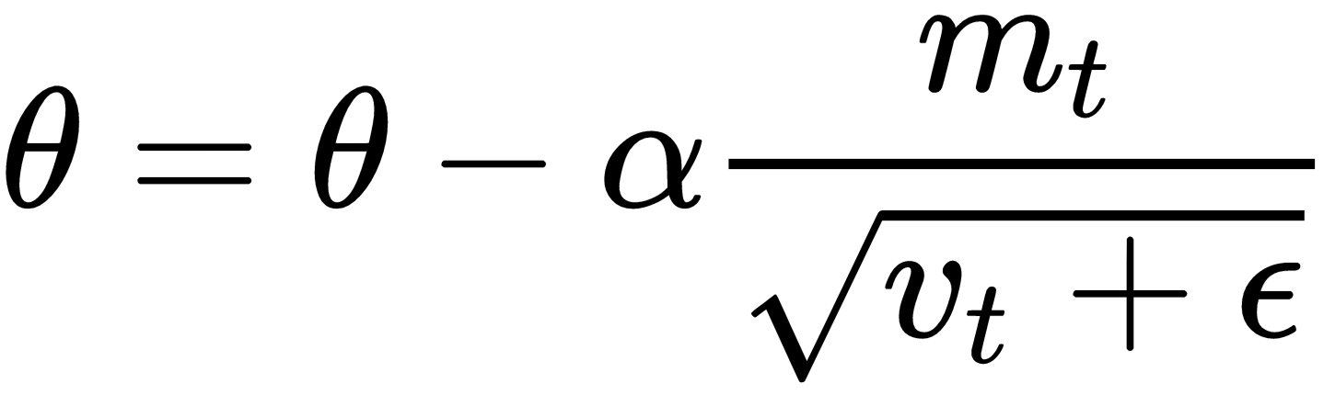
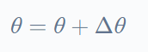
Cheat sheet
Stochastic
Gradient descent
Gradient descent
Ada delta
Ada grad
Adam
Gradient descent (GD) optimization iteratively reduces a loss function by moving in the direction opposite to that of steepest ascent.
Based on convex function
SGD reduces a loss function by updating the model parameters number of times equal to the total number of datapoints.
Based on updated weight vectors using one data point
Ada delta is SGD with no need for global learning rates and No continual decay of learning rates through out the training
Based on adaptive learning
Ada grad algorithm adaptively scale the learning rate for each dimension. It has decaying of squared parameters.
Based on adaptive learning.
Adam is ada grad with out minimal parameters choice.
Based on the estimation of first and second raw moment of historical gradients

Slide 6
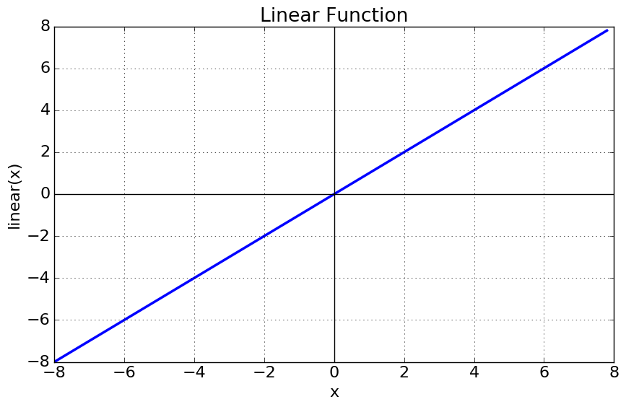
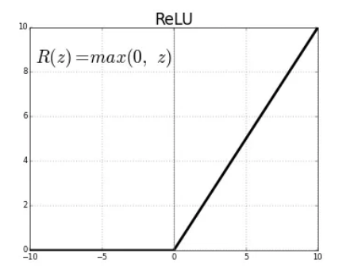
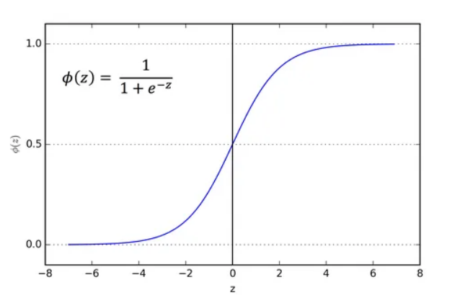
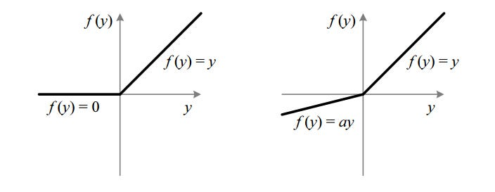
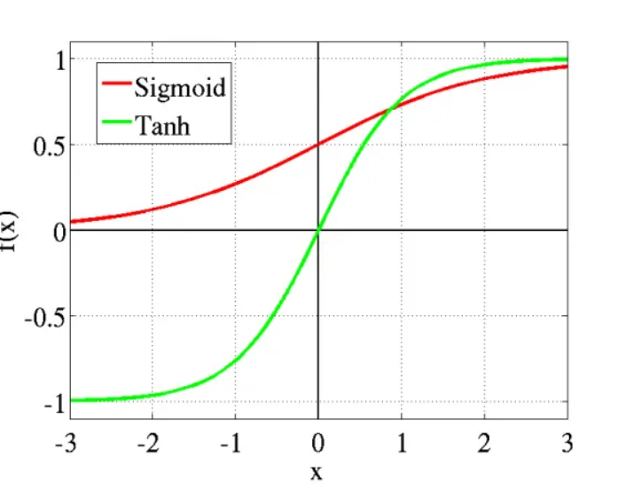
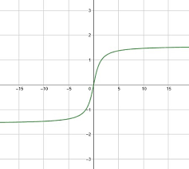
Types of ACTIVATION Function
Linear
RELU
Linear Activation Function
Sigmoid Function - Logistic
Tanh Function - tan hyperbolic
RELU Function
Soft max Function
Leaky ReLU
ArcTan
Sigmoid
Leaky ReLU
Tanh
ArcTan

Slide 7
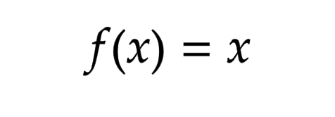
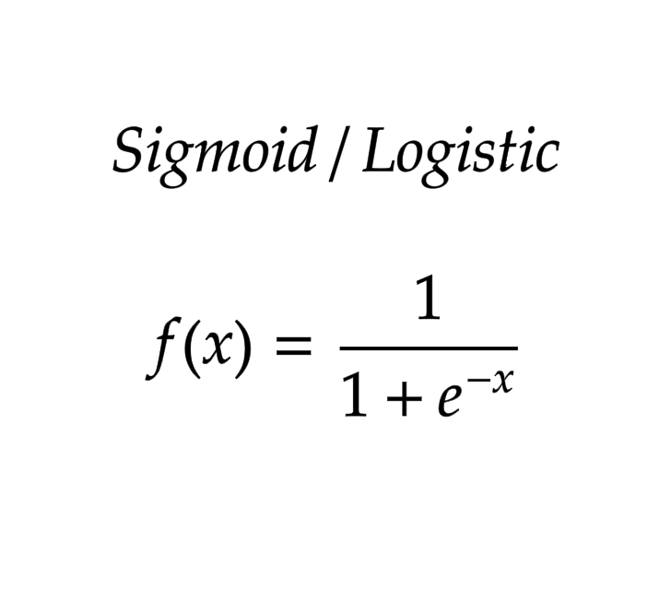
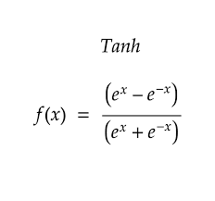
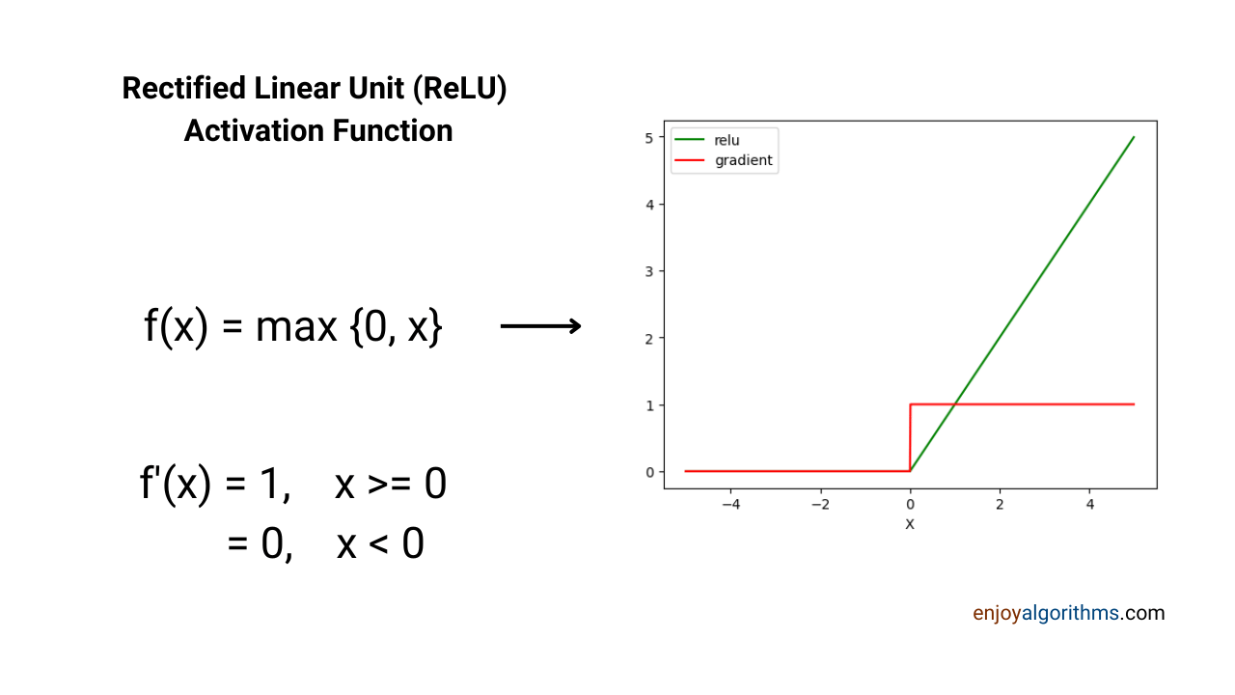
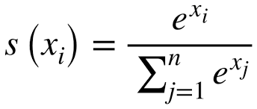
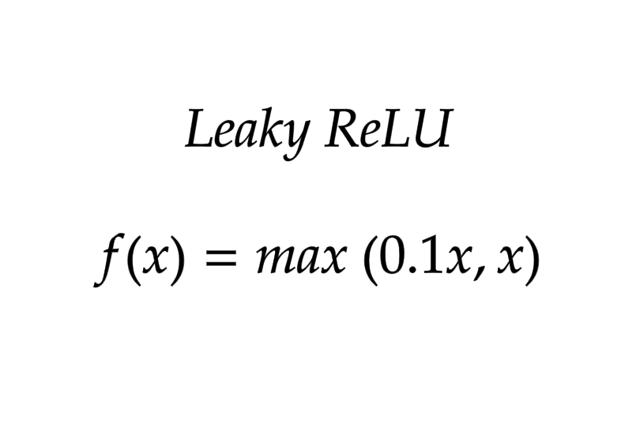
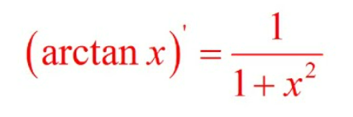
Cheat sheet
Linear
Linear activation is simply - ‘no activation’
Sigmoid
Mostly used for the output layer of binary classification tasks
Tanh
Used in the hidden layer of binary classification problems
RELU
Removes Vanishing Gradient Problem
used for multi-class classification tasks
Soft max
useful in deep neural networks with many negative inputs.
Leaky ReLU
ArcTan
Used to prevent neurons from saturating and it is robust against noisy data

Slide 8
Thank You

